Slide 1
Practical Data Science with R
@MatthewRenze
#NebraskaCode
Notes:
Quick show of hands:
- How many of you use data to make decisions every day?
- Have any of you used a statistical programming language like R?
- Does anyone have an advanced degree in data analysis or statistics?
[Pause]

Slide 2
Motivation
The ability to take data—to be able to understand it, to
process it, to extract value from it, to visualize it, to
communicate it—that’s going to be a hugely important
skill in the next decades, … because now we really do
have essentially free and ubiquitous data. So the
complimentary scarce factor is the ability to understand
that data and extract value from it.
Hal Varian, Google’s Chief Economist
The McKinsey Quarterly, Jan 2009
Notes:
To provide a bit of motivation for our workshop today, I’d like to read a quote from Google’s Chief Economist back in 2009.
…
[Pause]

Slide 3
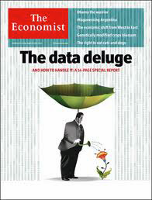
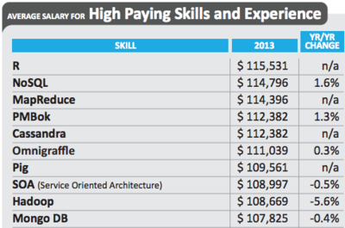
Source: Dice 2014 Tech Salary Survey Results
Notes:
This same sentiment has been expressed by experts across various industries.
In fact, I see articles like (these) popping up on a daily basis now.
[Pause]

Slide 4


A Flood of Data is Coming...
Source: http://www.dot.gov.nt.ca/
Source: Wikipedia
Sink or Swim
Notes:
Whether you realize it or not, there is a flood of data coming our way.
… In fact, the flood is already here, and it’s growing exponentially each year.
In the next decade or so, you’re going to see two completely different outcomes for people, businesses, and governments, based on whether they learn to use this data to their advantage or not.
Essentially, these people, business, and governments are either going to sink in this sea of data or they are going to learn to swim.
So, I’m currently doing what I can, in my professional life, to learn how to swim in this new data-driven economy… and I encourage you to do the same.
And this leads me to the purpose of our workshop today.
[Pause]

Slide 5

Overview
Introduction
Transforming Data
Descriptive Statistics
Data Visualization
Statistical Modeling
Handling Big Data
Machine Learning
R in Practice
Notes:
The purpose for our workshop is to learn a bit about R and how to use it for data science.
As an overview,
First, we’ll start with an introduction to data science and R.
Next we’ll learn how to transform and clean our data
Then, we’ll learn how to create and interpret Descriptive Statistics to numerically analyze our data
Next we’ll learn how to create an interpret Data Visualizations to visually analyze our data
Then, we’ll learn how to create an interpret statistical models to perform statistical inference.
Next we’ll learn about big data and how to handle big data scenarios in R
Then we’ll learn about machine learning and how to use it to make predictions in R
Finally, we’ll learn how to use R in practice (i.e. how to use R in production, create reproducible research, and I’ll share a few industry best practices)
[Pause]

Slide 6
How Does This Apply to Me?
As a software developer, I often:
Perform log file analysis
Analyze software performance
Analyze code metrics for code quality
Detect anomalies in source data
Transform or clean data files to make them usable
Help decision makers make decisions based on data
Notes:
So you might be thinking to yourself, “I’m not a statistician or a data scientist”, so how does this apply to me?
Well, as a software developer, I often:
…
In reality, we’re constantly working with data as software developers.
So having the skills necessary to transform data into actionable insight is a great skill to have.
In addition, It’s a lot easier to convince your boss that your idea is a good one if you can show them solid empirical evidence to back your claim.
[Pause]

Slide 7



About Me
Independent software consultant
Education
B.S. in Computer Science
B.A. in Philosophy
Community
Pluralsight Author
ASPInsider
Public Speaker
Open-Source Software
Notes:
Before we begin our workshop though, I’d like to tell you a bit about me: who I am, where I come from, and why I’m interested in this topic.
I’m an independent software and data science consultant with over 16 years of professional experience building large-scale data-driven desktop, server, and cloud-based applications.
I have double degrees in Computer Science and Philosophy, with a minor in Economics, and a focus on Artificial Intelligence and Machine Learning from ISU.
I’m also an author for Plurasight, an ASPInsider, an international public speaker, and I’ve created a few pretty cool open-source software projects.
[Pause]

Slide 8
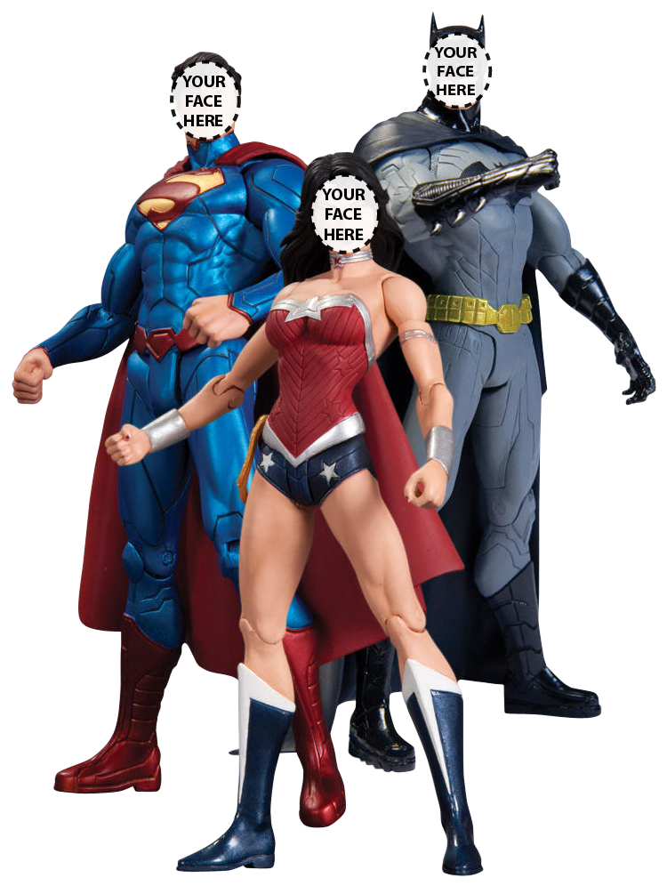
About You
What’s your name?
What do you do?
Why did you attend?
Favorite super power?
Source: www.thatsmyface.com
Notes:
Now that I’ve told you a bit about me, let’s learn a bit about all of you.

Slide 9
Logistics
Time table
8 Lectures (10 min)
8 Demos (5 min)
8 Labs (15 min)
Break in the middle
Pairing for labs is optional
Ask questions if needed
Come and go as needed
Feedback forms at the end
Notes:
Regarding logistics for the course, we’ll have 8 lectures, which will be roughly 10 minutes each.
8 labs which will be roughly 15 minutes each.
We’ll take a 15 minutes break in the middle.
You can pair up for labs if you’d like, but it’s totally cool if you’d rather work on your own.
Feel free to ask questions as they occur. However please be sure to help keep us on topic.
If you need to use the restroom, feel free come and go as you need.
Finally, we’ll have feedback forms at the end of the workshop where you will be able to help me improve this workshop for future attendees.

Slide 10
Workshop URL
http://www.matthewrenze.com/workshops/practical-data-science-with-r/
Notes:
All of the documents, labs, and data for the can be found on my website at the following URL.
Now would be a good time to head there and bookmark the website.

Slide 11
Introduction to Data Science
Notes:
First, let’s start with an introduction to data science.
[Pause]

Slide 12

What is Data Science
Interdisciplinary field
Derive insight from data
Transform data into knowledge
Source:www.drewconway.com
Notes:
The first question we need to answer is “What is Data Science?”
In essence, data science is an interdisciplinary field composed of:
- Computer Science
- Math and Statistics
- Domain expertise
… that seeks to derive insight from data.
In other words, the goal of data science is to transform data into knowledge.
… knowledge that we can use to make decisions.
On the right, we have Drew Conway’s data science Venn Diagram
It shows how Computer Science, Math & Statistics, and Domain Expertise combine to create Data Science.

Slide 13
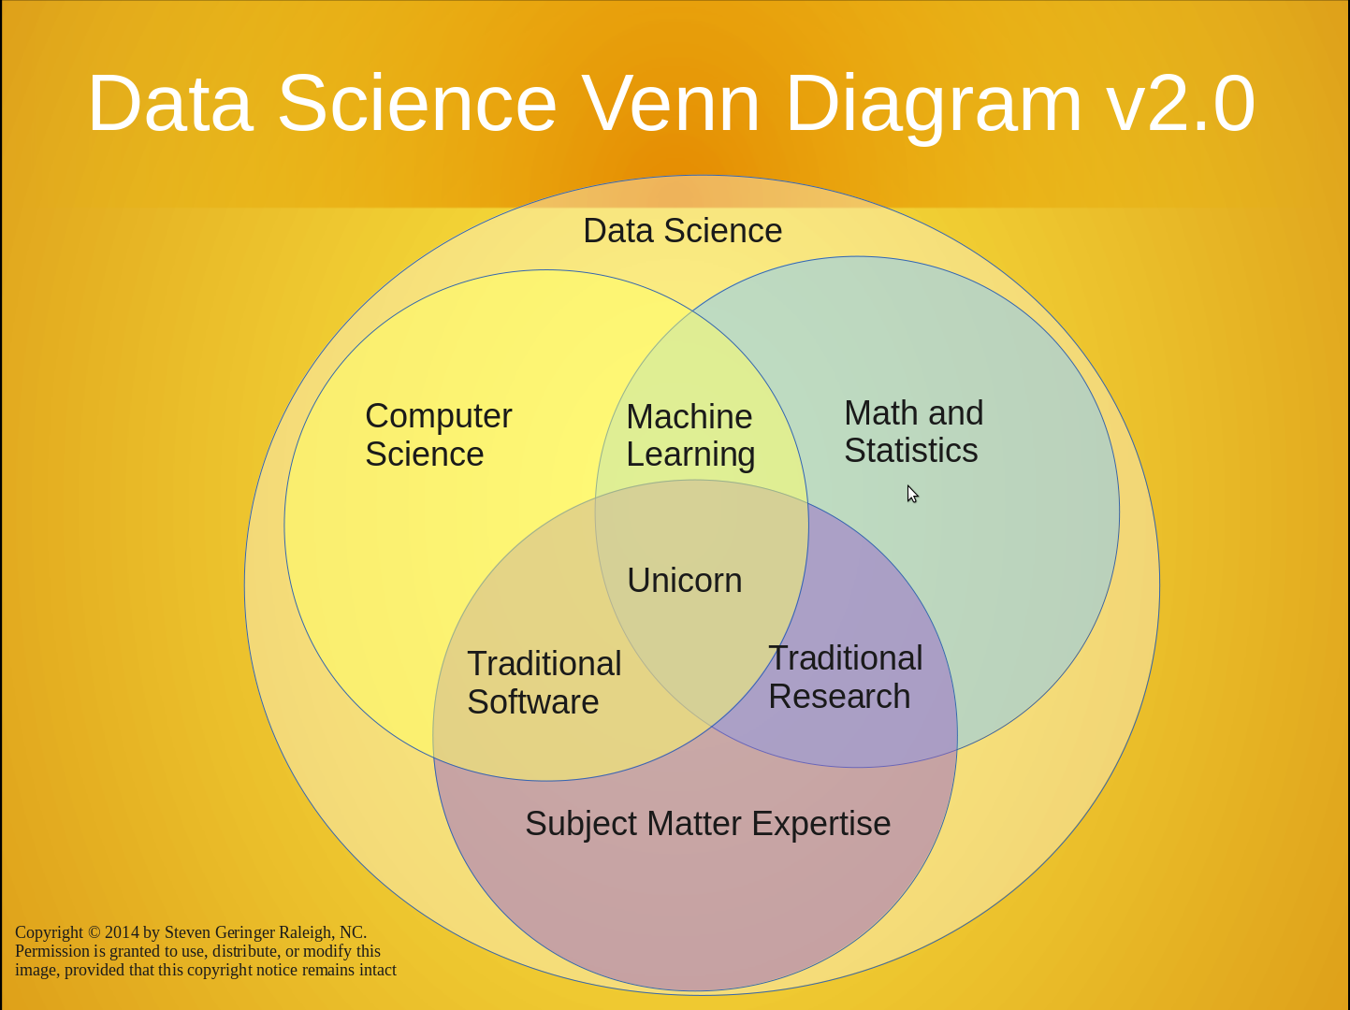
Notes:
However, I prefer the Data Science Venn Diagram (v2.0), which is based on Drew Conway’s original data science Venn diagram.
This version does a better job of capturing the relationship between the three disciplines and what their intersections represent.
Especially the “Unicorn” in the middle… because that’s essentially what most data scientists are perceived to be these days.
… a mythical beast that can turn data into gold using magical data science sorcery! : )
[FINISH]

Slide 14

What is a Data Scientist?
Performs data science
Proper accreditations
More than a scientist
More than an analyst
More than a developer
The Sexiest Job of the 21st Century
Source: http://www.clipartpanda.com
Notes:
So then what is a data scientist?
A data scientist is someone who performs data science for a living.
Technically, they also need to have a Ph.D. in computer science, statistics, or a similar field to refer to themselves as a properly as a scientist.
Coincidentally, this is why I refer to myself as a data science consultant rather than a data scientist.
However, a data scientist is more than just a scientist.
… more than a data analyst
… and more than just a developer
They possess all three sets of skills.
This is why the industry keeps referring to them as unicorns.
Individuals with all three sets of skills and proper credentials are currently very rare.

Slide 15
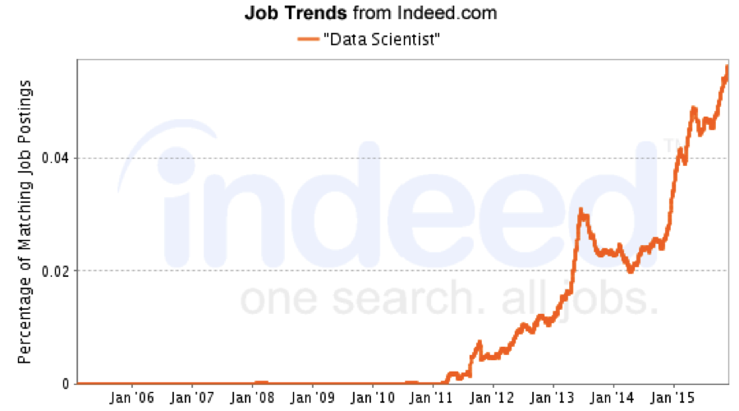
Notes:
However, despite how rare actual data scientists are, they are in very high demand.
In addition, that demand is growing every year, as we can see by the trend of job postings looking for data scientists.
So there is clearly a high demand for this specific set of skills.

Slide 16
The Data Science Toolkit
Programming
Data transformation
Descriptive statistics
Data visualization
Statistical modeling
Big Data
Machine learning
Notes:
So what set of skills does a data scientist possess?
[Read List]

Slide 17
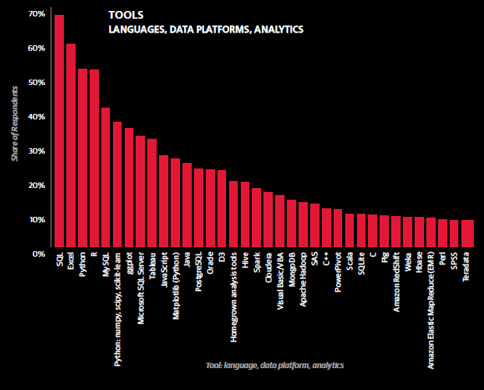
Source: O’Reilly 2015 Data Science Salary Survey
Notes:
Regarding tools of the data scientists.
Here are the tools used by the respondents to O’Reilly’s Data Science Salary Survey in 2015.

Slide 18
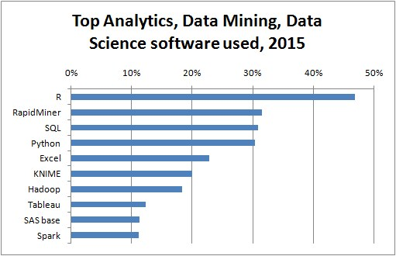
http://www.kdnuggets.com/polls/2015/analytics-data-mining-data-science-software-used.html
Notes:
… and here are the top analytics, data mining, and data science software used by respondents of KDNuggets 2015 survey.

Slide 19
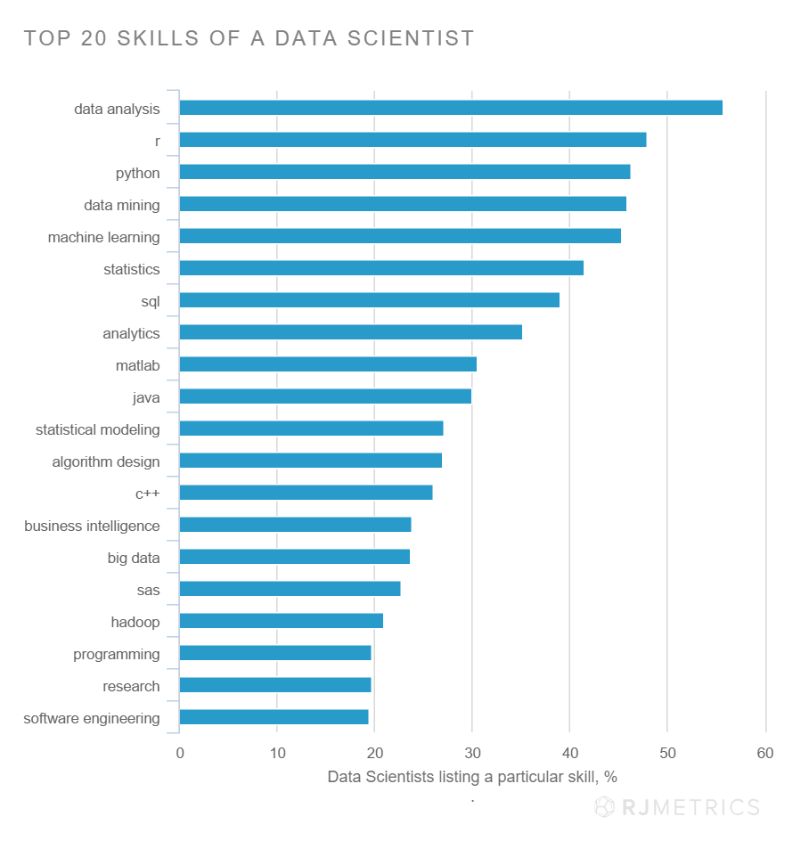
Notes:
… and finally the top skills for data scientist mined from Linked In profiles shows the following:

Slide 20
Why is Data Science Important?
Lots of data
Fast computers
Powerful analysis tools
Prediction vs. explanation
Notes:
So why has data science become so important all of a sudden?
There are a few trends really driving the importance of data science.
First, we now have lots of cheap and ubiquitous data.
Second, we have very fast and cheap computers that can process all of these data in a reasonable amount of time and at low cost.
Third, we have excellent tools for statistical analysis and machine learning algorithms that can find patterns and make predictions with these data.
Finally, we’ve entered an era where we’re now using computers to predict what will happen rather than just explain what has already happened.

Slide 21

The Data Science Process
Ask a question
Explore the data
Prepare the data
Create a model
Evaluate the model
Deploy the model / results
https://en.wikipedia.org/wiki/Cross_Industry_Standard_Process_for_Data_Mining
Notes:
The general data science process works like this:
First, we find a question that we want to answer.
Second, we explore the data to understand what we have available, what we need to collect, and what condition the data are in
Third, we prepare the data for analysis (this is called data munging)
Fourth we create a model (this can be either be a numerical model, visual model, statistical model, or machine learning model.
Fifth, we evaluate the model to determine if it answers our questions and if it is appropriate given our data and context.
Finally, if everything looks good, we deliver our results or deploy our model.
This could mean either communicating our findings to others, publishing a data visualization, or implementing a statistical or machine learning model in production.

Slide 22
The Data Science Process
Iterative process
Non-sequential
Early termination
Established process (CRISP-DM)
https://en.wikipedia.org/wiki/Cross_Industry_Standard_Process_for_Data_Mining
Notes:
This is typically an iterative process (i.e. we typically go through the complete cycle multiple times).
In addition, it’s often non-sequential (i.e. we often have to bounce back and forth between steps).
Also, we don’t always need to complete the process, often, we learn that what we’re doing isn’t working or doesn’t make sense, so we terminate the process and try something else before we’re finished.
There are some well established practices for the data science process like the CRISP-DM process (Cross Industry Standard Process for Data Mining) like the diagram show.
These are useful as a guide during the data science process.

Slide 23
Introduction to R
Notes:
Next we’ll introduce R.
[Pause]

Slide 24
What is R?
Open source
Language and environment
Numerical and graphical analysis
Cross platform
Notes:
The first question you might have is: What is R?
R is:
- a free open-source implementation of the statistical programming language S
- R is both a programming language and an environment within which to program
- provides methods for both numerical and graphical data analysis
- and it’s cross-platform, so it runs on Windows, Mac, and Unix systems
[Pause]

Slide 25
What is R?
Active development
Large user community
Modular and extensible
6700+ extensions
and best of all…
Notes:
In addition, R is:
- actively under development
- has a large user community
- is very modular and extensible
- has over 6700 extension packages
… and best of all R is free open-source software meaning it’s …
[Pause]

Slide 26

FREE
Notes:
Free as in beer… meaning, anyone can use the software without cost.

Slide 27

FREE
Notes:
And free, as in speech… meaning you can view the source code, learn from it, modify it, or redistribute it, as you wish.
[Pause]

Slide 28
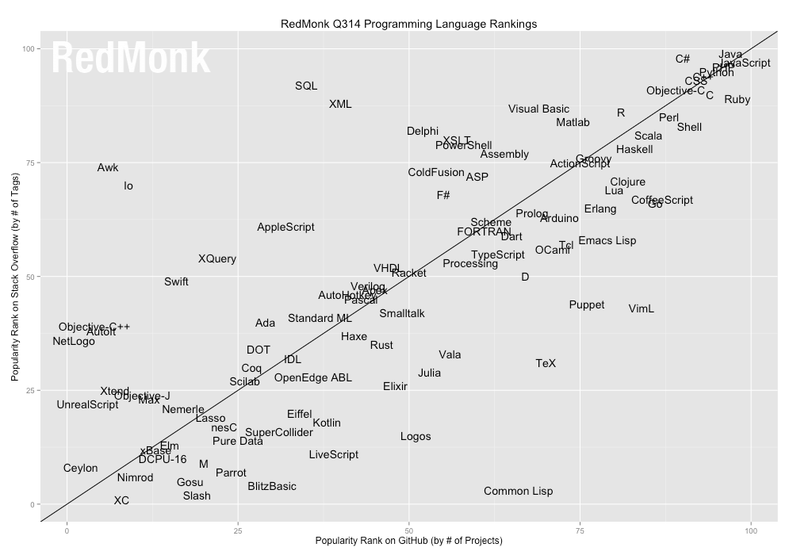
Source: http://redmonk.com/sogrady/2014/06/13/language-rankings-6-14/
Notes:
As I mentioned, R is a very popular programming language, so here’s a quick visualization to show us where it lies in terms of programming language popularity.
On the x-axis we have programming language popularity rank on GitHub.
On the y-axis we have popularity rank on Stack Overflow.
As you can see at the top corner, we have the very popular general purpose programming languages (e.g. C#, Java, and Python)
In this next cluster, we have the popular more specialized languages (e.g. Matlab, SQL, and Lisp)
And finally, down here, we have the less popular languages.
Here we have R, right at the top of the specialized languages.
I should note that R will likely never be as popular as general-purpose languages.
… it’s specialized to work with data extremely well, but you probably won’t be using it to build your next ecommerce website anytime soon.
[Pause]

Slide 29
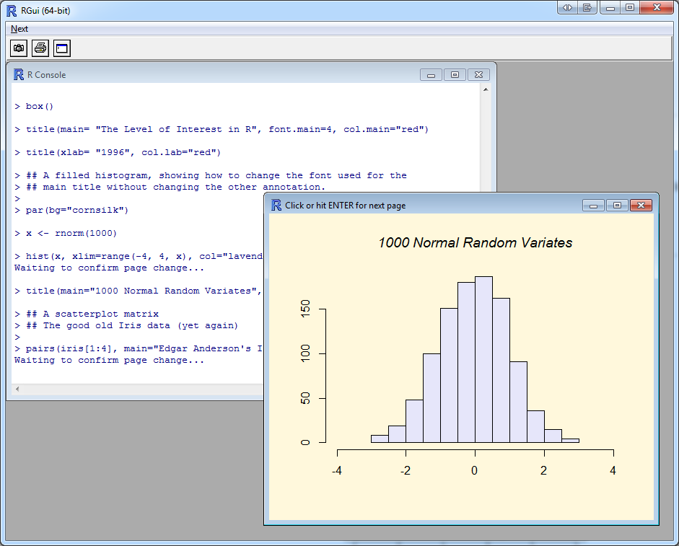
Notes:
This is what R looks like.
As you can see, we have both a programming language and an environment.
In addition, you can see that R can do both numerical analysis and graphical analysis as well.
[Pause]

Slide 30
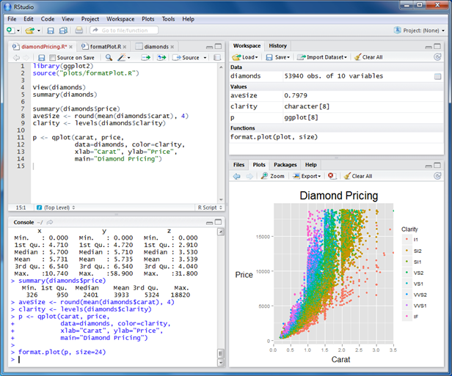
Source: www.rstudio.com/ide/
Notes:
Rather than working with the out-of-the-box R IDE today, we’re going to use a more powerful IDE for R, called R-Studio.
It’s still R under the hood, but the IDE is much better and makes it much easier to do code demos.
We’ll walk through the IDE during our first code demo next.

Slide 31
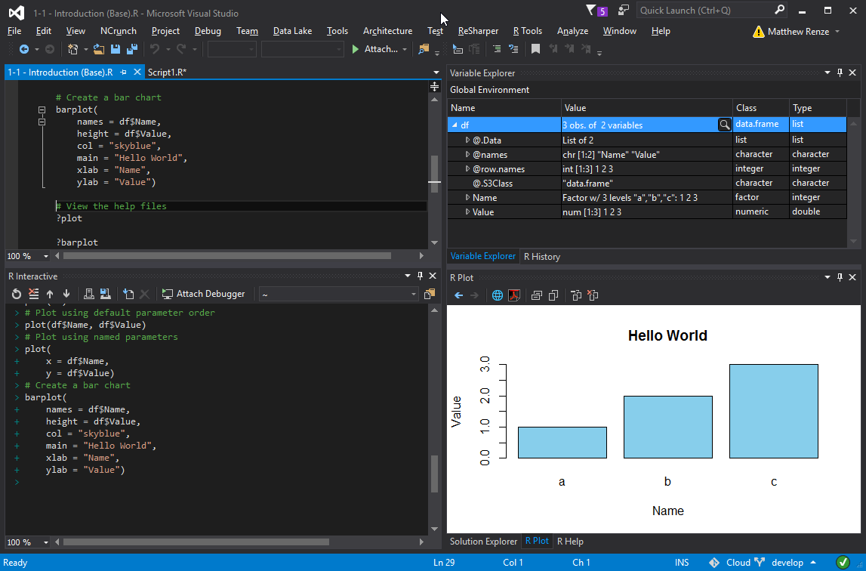
Notes:
In addition, I should also point out that there is now support for R in Microsoft Visual Studio as well.
So in addition to using the R IDE and Rstudio, you can now also use the Visual Studio IDE to create R code as well.

Slide 32
Code Demo
Notes:
Ok… enough talking.
Lets see some code.
[Hello World]
[IDE walkthrough]

Slide 33
Lab 1 R Programming Basics

Slide 34
Transforming Data
Notes:
Ok, now we’re going to start looking at how to perform EDA with R.
The first step in EDA is to prepare the data for the analysis, this step is commonly referred to as Data Munging.
[Pause]

Slide 35
Data Munging
Transforming data
Raw data to usable data
Data must be cleaned first
Notes:
Data munging is popular term, amongst data scientists, for transforming data from it’s raw form to a form suitable for data analysis
aka: data wrangling, data cleaning, data cleansing, or ETL (Extract, Transform, and Load)
We do this because most data sets are not initially ready for analysis, so the data must be transformed or cleaned first.
[I personally hate the term “munging”]
[Pause]

Slide 36
Data Munging Tasks
Renaming variables
Data type conversion
Encoding, decoding or recoding data
Merging data sets
Transforming data
Handling missing data (imputing)
Handling anomalous values
Notes:
When we’re munging data, we’re typically doing several tasks, including things like:
…
[Pause]

Slide 37
Loading Data in R
File-based data
Web-based data
Databases
Statistical data
And many more…
CSV
XML
∑
Notes:
The first step in data munging is to get the data into R.
Luckily for us, R supports a wide variety of data sources, including:
- File-based data (e.g. CSV, TAB, and Excel)
- Web-based data (e.g. XML, HTML, and JSON)
- Databases (e.g. SQL Server, Oracle, and MySQL)
- Statistical data files (e.g. SAS, SPSS and Stata)
- And many more…
[Pause]

Slide 38

Cleaning Data
This step is often the:
Most difficult
Most time consuming
TIP: Record all steps
Notes:
The second step in data munging is transforming and cleaning the data.
Unfortunately, this step is often the most difficult and the most time consuming.
So my recommendation to everyone is to record all steps using a script so you can reapply the steps whenever they are needed.
Because it inevitable that you’ll be on step 50 of a data analysis and realize that you’ve made a mistake.
You don’t want to have to go back and re-apply every step by hand.
In addition, once you’ve performed a data analysis, you’ll likely be asked perform it again a year later with the latest data.
If you have the script, you just point it at the new data and press “Run”.
[Pause]

Slide 39

Notes:
For our data munging demo, we’re going to be working with a data set from the Open Movies Database containing a selection of movies released in the US between the year 2000 and the summer of 2015.
We will only be including movies that have a rating of G, PG, PG-13, or R that have a reported box-office revenue.
In order to keep things interesting though, we’re going create a fictional narrative to help motivate the remainder of our demos.
Imagine for me if you will that we work at a Hollywood movie studio.
However, this studio doesn’t produce blockbuster movies, they produce the really bad “B” movie versions of major blockbuster movies.
In addition, we have a coworker named Joe who works in the finance department of this movie studio.

Slide 40

Notes:
One day, Joe comes to you one day in a panic.
He says, I’ve got this report that I need to have done by the end of the day, but I can’t load it into my analysis software.

Slide 41
Column with wrong name
Rows with missing values
Runtime column has units
Revenue in multiple scales
Wrong file format
Notes:
- [1] there’s a column with the wrong name (something about a rotten tomato)
- [2] there are rows with missing values
- [3] the movie runtime column contains the abbreviation for “minutes” in each row, next to the actual runtime
- [4] the box-office revenue column contains revenue in whole dollars, thousands of dollars, and millions of dollars.
- [5] and the file uses tabs instead of commas to separate the values in the file
So Joe knows you’re a programmer and he thinks you’re a pretty smart guy or gal.
So you say to Joe, “you know Joe, I was at this conference last week and I learned about this programming language called R.”
… “I think I can help you out”.
So we’re going to help Joe clean up his data file so he can finish his report by the end of the day.

Slide 42
Code Demo

Slide 43
Lab 2 Transforming Data

Slide 44

Notes:
So we hand this CSV file to Joe, he runs his analysis, completes his report, hands it to the CEO and we’ve saved the day.
Joe doesn’t get fired… in fact, the CEO is so impressed that they promote him to CFO!
[1] So Joe takes us out to the bar to celebrate our success and his new promotion.
[STOP]

Slide 45
Descriptive Statistics
Notes:
The second aspect of data science that we’re going to look at is descriptive statistics.
[Pause]

Slide 46
Descriptive Statistics
Describe data
Provides a summary
aka: Summary statistics
Movie Runtime
Statistic | Value (minutes)
Minimum | 38
1st Quartile | 93
Median | 101
Mean | 104
3rd Quartile | 113
Maximum | 219
Notes:
Descriptive statistics describe data in qualitative or quantitative ways.
In data science, we often need to summarize the shape or feel of the data in numerical ways.
These are often referred to as summary statistics.
For example, in this table, we have summary statistics for a single variable in our data set called “Movie Runtime”…
[Pause]

Slide 47
Statistical Terms
Observations
Variables
Qualitative variable
Quantitative variable
ID | Date | Customer | Product | Quantity
1 | 2015-08-27 | John | Pizza | 2
2 | 2015-08-27 | John | Soda | 2
3 | 2015-08-27 | Jill | Salad | 1
4 | 2015-08-27 | Jill | Milk | 1
5 | 2015-08-28 | Miko | Pizza | 3
6 | 2015-08-28 | Miko | Soda | 2
7 | 2015-08-28 | Sam | Pizza | 1
8 | 2015-08-28 | Sam | Milk | 1
Notes:
I don’t want to go too deep into statistics for this presentation, but in order to understand descriptive statistics, we need to understand a few basic terms from statistics.
- Observations - Rows in the table
- Variables - Columns in the table (they are called variables because the values vary for each observation)
- Qualitative variable - Categorical values (e.g. customer, product)
- Quantitative variable - Numeric values (e.g. quantity of products sold)
[Pause]

Slide 48
Types of Analysis
Number of variables
Univariate
Bivariate
Multivariate
Type of variables
Qualitative
Quantitative
Qualitative
Univariate
Analysis
Quantitative
Univariate
Analysis
Qualitative
Bivariate
Analysis
Qualitative & Quantitative
Bivariate
Analysis
Quantitative
Bivariate
Analysis
Number of Variables
Multivariate
Analysis
Type of Variable(s)
Notes:
There are several types of analysis we can do, which are dependent upon:
Number of variables
- Univariate - One
- Bivariate - Two
- Multivariate – Many
Type of variables
- Qualitative – Categorical
- Quantitative – Numerical
[Pause]

Slide 49
Qualitative Univariate Analysis
One categorical variable
Frequency of observations
Qualitative
Univariate
Analysis
Quantitative
Univariate
Analysis
Qualitative
Bivariate
Analysis
Qualitative & Quantitative
Bivariate
Analysis
Quantitative
Bivariate
Analysis
Number of Variables
Multivariate
Analysis
Type of Variable(s)
Notes:
The first type of analysis we can perform is qualitative univariate analysis, which is just a fancy term for the analysis of one categorical variable.
When we’re performing qualitative univariate analysis (i.e. the analysis of one categorical variable) we’re typically interested in the frequency of observations contained in a specific category.
That is, the count of rows grouped by a specific category (for the SQL programmers).

Slide 50
Quantitative Univariate Analysis
One numeric variable
Measures
Central tendency
Dispersion
Qualitative
Univariate
Analysis
Quantitative
Univariate
Analysis
Qualitative
Bivariate
Analysis
Qualitative & Quantitative
Bivariate
Analysis
Quantitative
Bivariate
Analysis
Number of Variables
Multivariate
Analysis
Type of Variable(s)
Notes:
The second type of analysis we can perform is quantitative univariate analysis, which is just a fancy term for the analysis of one numeric variable.
When we’re preforming quantitative univariate analysis we’re typically interested in measures of:
Central tendency – location of the center of the data
- Mean
- Median
- Mode
Dispersion – spread of the data
- Min
- Max
- Range
- Quartiles
- Variance
- Standard deviation
[Pause]

Slide 51
Qualitative Bivariate Analysis
Two categorical variables
Joint frequency
Contingency tables
Qualitative
Univariate
Analysis
Quantitative
Univariate
Analysis
Qualitative
Bivariate
Analysis
Qualitative & Quantitative
Bivariate
Analysis
Quantitative
Bivariate
Analysis
Number of Variables
Multivariate
Analysis
Type of Variable(s)
Notes:
Bivariate analysis, is just a fancy term for two-variable analysis.
First, we have qualitative bivariate analysis (i.e. analysis of two categorical variables).
In qualitative bivariate analysis we’re typically interested in the joint frequency of observations across two categories.
We represent these joint frequencies in something called a contingency table (i.e. a two-dimensional frequency table).

Slide 52
Quantitative Bivariate Analysis
Two numeric variables
Predictor
Outcome
Measures
Covariance
Correlation
Qualitative
Univariate
Analysis
Quantitative
Univariate
Analysis
Qualitative
Bivariate
Analysis
Qualitative & Quantitative
Bivariate
Analysis
Quantitative
Bivariate
Analysis
Number of Variables
Multivariate
Analysis
Type of Variable(s)
Notes:
Next, we have quantitative bivariate analysis (i.e. analysis of two numeric variables)
In quantitative bivariate analysis, we’re looking at the relationship between two variables.
- Predictor (Independent)
- Outcome (Dependent)
Measures include:
- Covariance – degree to which the two variables vary with one another
- Correlation – covariance on a standardized scale
[Pause]

Slide 53
Qualitative and Quantitative Bivariate Analysis
One categorical variable
One numeric variable
Aggregate measures
Sum
Average
Qualitative
Univariate
Analysis
Quantitative
Univariate
Analysis
Qualitative
Bivariate
Analysis
Qualitative & Quantitative
Bivariate
Analysis
Quantitative
Bivariate
Analysis
Number of Variables
Multivariate
Analysis
Type of Variable(s)
Notes:
Then we have bivariate analysis for both a qualitative and a quantitative variable (i.e. analysis of both a categorical and a numeric variable)
In this type of analysis we’re typically interested in the an aggregate measure of a numeric variable grouped by a categorical variable.
Measures include:
- Average or arithmetic mean
- Sum or total
[Pause]

Slide 54
Multivariate Analysis
Many variables
Specific meaning in statistics
Qualitative
Univariate
Analysis
Quantitative
Univariate
Analysis
Qualitative
Bivariate
Analysis
Qualitative & Quantitative
Bivariate
Analysis
Quantitative
Bivariate
Analysis
Number of Variables
Multivariate
Analysis
Type of Variable(s)
Notes:
Finally, we have multivariate analysis, which generically means the analysis of many variables.
However, in statistics, multivariate analysis has a more precise meaning than just the analysis of many variables.
The distinction is a bit difficult to explain, so I think we’ll skip it for today.

Slide 55

Notes:
Now lets switch gears and take a look at a demo of descriptive statistics.
So our coworker Joe is now CFO of our low-budget Hollywood B-movie studio.
He really wants to impress the board of directors and show them that he’s got what it takes to make good financial decisions.

Slide 56







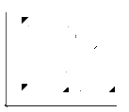
Cowboys &
Space Invaders:
The Musical
Extended Edition
Notes:
While we’re having drinks together at the bar, Joe tells us that he’s come up with a great idea to make a new, highly profitable, low-budget, b-movie for the studio.
He says he’s been watching a lot of movies lately, and he thinks that the movie industry, is just dying for an avant-garde,
[1] Sci-Fi,
[2] Western,
[3] Musical… that’s an
[4] R-rated
[5] 3-hour epic!
He says the critics will hate it, but the audiences will love it, and he predicts that the box office revenue will be off the charts…
Well, we’re a science-y kind of person… and so we’re a bit skeptical of Joe’s claim.
In addition, we just so happen to have our laptop, and the movies data set at the bar with us… like any good programmer would.
So let’s try to see if joe’s claim holds any water, by determining which types of movies, brought in the highest box office revenue, from 2000 to 2015.
… and if Joe’s avant-garde, 3-hour, R-Rated, Sci-Fi, Western, Musical might be a box-office hit or a disaster.

Slide 57
Code Demo

Slide 58
Lab 3 Descriptive Statistics

Slide 59


Cowboys &
Space Invaders:
The Musical
Extended Edition
Notes:
So we conclude, with our back-of-the-napkin guesstimate, that Joe’s 3-hour, R-rated, Sci-fi, Western, Musical might not be such a good idea.
… and that a PG-rated fantasy action/adventure movie might be a safer bet, than.
… provided that Joe’s only goal is to maximize box office revenue.
So we walk Joe through our analysis…
[1] he realizes we may have just saved him from a big financial disaster…
In addition, it’s important to note that we’re having a bit of fun with this analysis.
Movies are a very complex form of art, and audience preference for movies, is even more complex, and changes from year to year.
While we can use our movies data set to say what happened in the past, attempting to predict whether a movie will perform well at the box office, is a more complex task, and well beyond the scope of the analyses we will be performing in this workshop.
[Pause]

Slide 60
Data Visualization
Notes:
Now let’s take a look at data visualization.
[Pause]

Slide 61
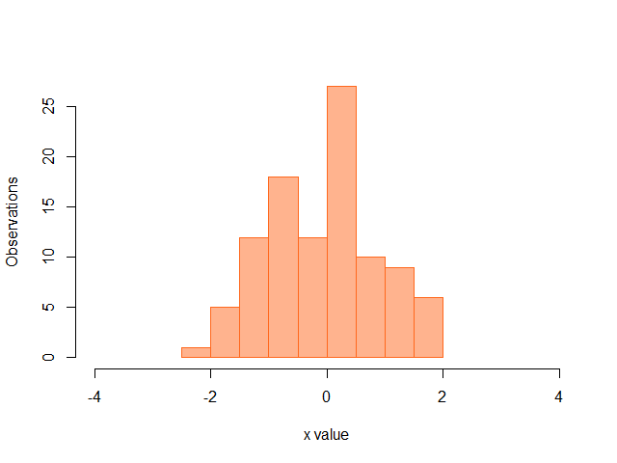
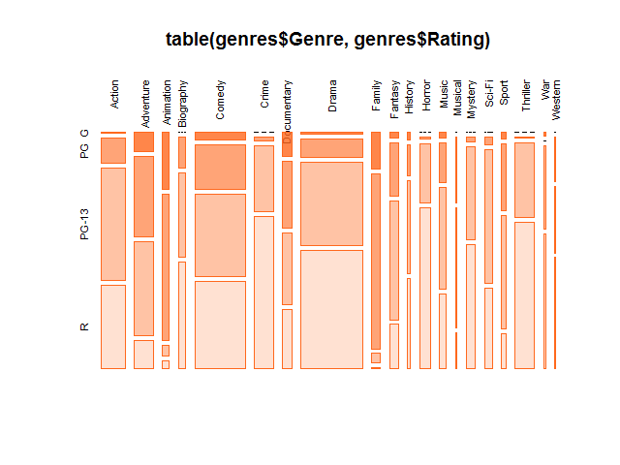
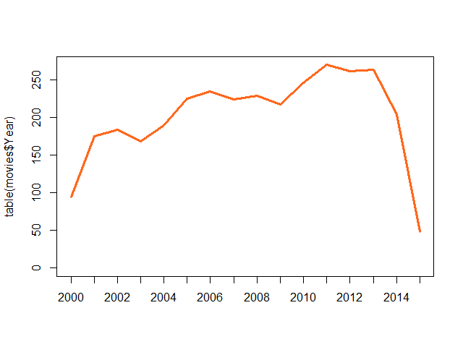
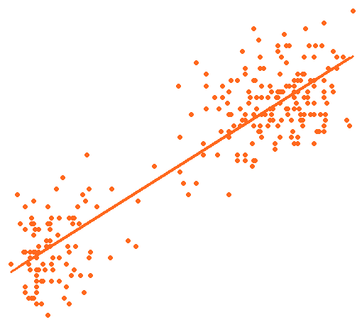
Data Visualization
Visual data representation
For human pattern recognition
Map dimensions to visual characteristics
Notes:
Data visualization is the representation of data via visual means.
We do this because the human brain is exceptionally good at visual pattern recognition.
The idea is to map dimensions of data to visual characteristics:
- Location
- Color
- Size
- Shape
[Pause]

Slide 62
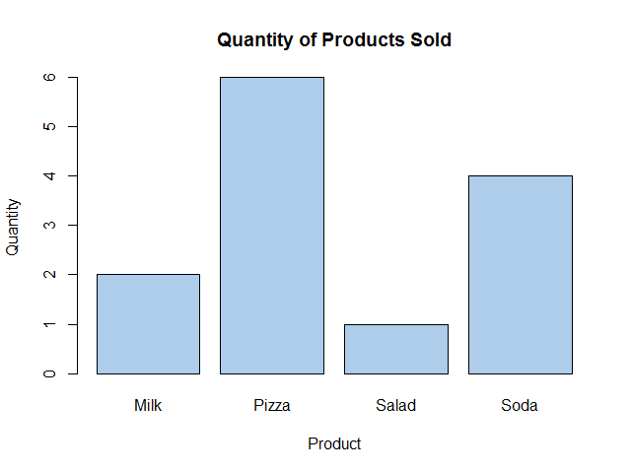
Data Visualization
ID | Date | Customer | Product | Quantity
1 | 2015-08-27 | John | Pizza | 2
2 | 2015-08-27 | John | Soda | 2
3 | 2015-08-27 | Jill | Salad | 1
4 | 2015-08-27 | Jill | Milk | 1
5 | 2015-08-28 | Miko | Pizza | 3
6 | 2015-08-28 | Miko | Soda | 2
7 | 2015-08-28 | Sam | Pizza | 1
8 | 2015-08-28 | Sam | Milk | 1
Notes:
If we look at this table, it’s a bit difficult to quickly determine if we sold more salads or more pizza.
However, if we look at this chart, we can quickly see that we sold way more pizza than salads.
Data visualizations allow us to quickly see patterns in data that might take us longer using numerical analysis techniques.
[Pause]

Slide 63
Types of Data Visualizations
Number of variables
Univariate
Bivariate
Multivariate
Type of variable(s)
Qualitative
Quantitative
Qualitative
Univariate
Analysis
Quantitative
Univariate
Analysis
Qualitative
Bivariate
Analysis
Qualitative & Quantitative
Bivariate
Analysis
Quantitative
Bivariate
Analysis
Number of Variables
Multivariate
Analysis
Type of Variable(s)
Notes:
Once again, there are various types of data visualizations we can do, which are dependent upon:
Number of variables:
- Univariate
- Bivariate
- Multivariate
Type of variables:
- Qualitative - Categorical
- Quantitative – Numerical
[Pause]

Slide 64

Cowboys &
Space Invaders:
The Musical
Extended Edition
Notes:
So our coworker and CFO Joe says to us “ya know, I’m not really much of a numbers guy, and I’m kinda drunk. “
… “But if you could show me a chart or a graph, I think you could convince me that my movie is a bad idea.”
So we’re going to help Joe once again by trying to show the same information in a visual way.
… and try to convince him that he should probably focus on a new movie… or a new career for that matter… and probably stop drinking.

Slide 65
Code Demo

Slide 66
Lab 4 Data Visualization

Slide 67






The
Warlord
of the
Rings :
An Unexpected Adventure
Feature Length
PG
Notes:
So Joe finally agrees with us that his original movie idea wasn’t all that good, so he heads back to the drawing board and comes up with a new completely original idea.
[1] He pitches his new movie idea to the board of directors, which is an:
[2] action,
[3] fantasy,
[4] adventure,
[5] that’s rated PG
[6] and is 100 minutes long
Joe thinks it’s destined to be a classic that the whole family will enjoy! : )

Slide 68
Statistical Modeling
Notes:
Now we’re going to learn about statistical modeling and how to create and interpret statistical models.

Slide 69
Statistical Models
Representation of reality
Mathematical function
Parametric models
Non-parametric models
Notes:
A statistical model is a simplified (or abstracted) representation of reality using mathematical or statistical equations.
This means that we’re using mathematical equations to approximate what we are observing in reality.
In statistics, we’re typically trying to model the source that generated the data we are observing as a mathematical function.
We typically use a parametric models, which means that the mathematical equation has a fixed number of parameters that we adjust to make the model fit the data.
For example, the mean and standard deviation of a normal distribution are the only two parameters we need to describe the distribution for a given set of data.
In addition, for a linear model, the equation y = m * x + b we only need to specify the slope and the y-offset to define the function that describes how the data are related.
There are also, however, non-parameteric models where the number and nature of parameters are not fixed in advance but grows with the complexity of the data.
They’re a bit more complicated, than parameteric models, so we’re not going to be covering them in this workshop.

Slide 70
Types of Statistical Models
Probability distribution
ANOVA
Linear regression
Non-linear regression
Bayesian network
Notes:
There are many types of statistical models we can create once again depending upon the number of variables and the types of variables.
Single continuous variable => Probability distribution
Multiple variables with categorical explanatory variable => ANOVA
Multiple variables with continuous explanatory variables => Linear regression
Note: both ANOVA and Linear Regression are “Linear Models”
Beyond these basic models, we have more complex models like
- non-linear regression, where the data do not fit a straight line
- and Bayesian networks, where the likelihood of outcomes is modeled as a graph of dependencies of conditional probabilities
For this workshop, however, we’re only going to be focusing on linear regression

Slide 71
Simple Linear Regression
Linear model
Relationship between variables
Continuous explanatory variable
Single scalar dependent variable
Notes:
Simple linear regression is a special case of linear regression where we’re modeling the relationship between two variables.
We have a continuous explanatory variable (on the x-axis) otherwise we’d be performing ANOVA if it were categorical
And we have a single scalar dependent variable (on the y-axis)
If we had more than one explanatory variable, we would be performing multiple linear regression (instead of simple linear regression)
In addition, if we had multiple correlated dependent variables, we would be performing multivariate linear regression.
However, we’re just going to be focusing on simple linear regression in this workshop.

Slide 72
Simple Linear Regression
Linear predictor function
y = m · x + b
Parameters estimated from data
Makes certain assumptions
Notes:
With simple linear regression, we’re using a linear predictor function (which is a fancy way to say we’re using the equation for a straight line).
Then we’re estimating the parameters of this predictor function from the data
That is, we use the data to determine the slope (m) and the y-intercept (b) that best fit all of the data points.
Linear regression makes a few key assumptions about the data, which include:
- linearity (i.e. the data follow a straight line)
- and homoskedastisicty (i.e. the variability of the data stays roughly the same for the length of the line)
If these assumptions are incorrect, linear regression not valid for the data.

Slide 73
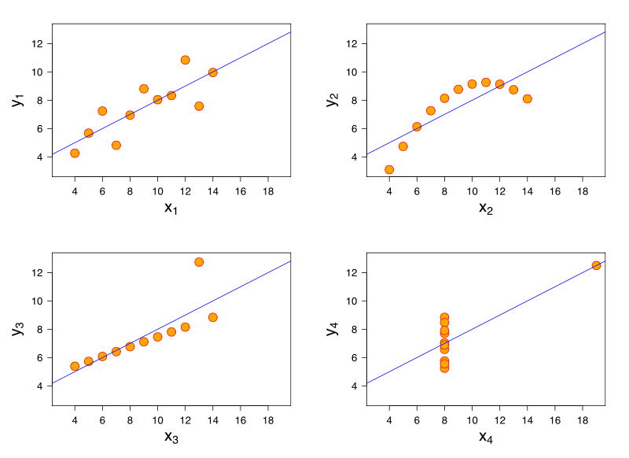
Source: https://en.wikipedia.org/wiki/Anscombe%27s_quartet
Notes:
Just to demonstrate how violating these assumptions can create invalid linear models, all four of these plots are modeled by the exact same linear regression line.
However, I think we can all agree that a linear model does not model these data very well.
This is why it is important that we understand what assumptions a statistical model is operating under and that we take the time to explore our data (for problems like theses) before we model it.

Slide 74

Notes:
One night as we’re having drinks at the bar after work, Joe tells us that he lost his passion for creating cheap knockoffs of Hollywood blockbuster movies.
He tells us that his real passion in life has always been plants, specifically flowers.
He’s been thinking about getting out of the movie business to open his own high-end flower shop to cater to the stars in Hollywood.
Apparently, through his Hollywood connections, he’s discovered that there is a huge market for selling flowers that match the buyers exact specifications.
They use them to create very expensive artwork and elaborate floral decorations, so the flower petals need to be roughly all the same size and shape to be aesthetically pleasing.
However, they are willing to pay top dollar for someone that can provide batches of flowers with all of the correct dimensions and characteristics.

Slide 75

Photo by Danielle Langlois
Notes:
To pull this off, Joe’s come up with an ingenious way to quickly measure the length of the petals of a specific type of flower called an “Iris” using a optical scanner.
However, this method doesn’t work well for the width of the petals, since they tend to bend more and thus can’t be measured accurately by the optical scanner.
But he’s noticed that the length and width of the petals look like they may be related to one another.
So he collected precise measurements of 50 randomly selected flowers from three different types of Iris flowers (for a total of 150 flowers).
His data set contains the:
- Petal Length – that is, the average length of the petals on the Iris flower in centimeters
- Petal Width – that is, the average width of the petals on the flower in centimeters
- Sepal Length – that is, the average length of the sepals (which are the leaf-like structure that encloses the petals until the flower blooms)
- Sepal Width – that is, the average width of the sepals
- and Species – of which there are three species of Iris flower he’s selling “iris virginica”, “iris versicolor”, and “iris setosa”.
He asks us if we could analyze the data he collected to see if there might be a way to predict the width of the petals given one of the other measures in the data set.
We offer to take a look at Joe’s data set to see what we can do for him.

Slide 76
Code Demo

Slide 77
Lab 5 Statistical Models

Slide 78



Photos by Radomił Binek, Danielle Langlois, and Frank Mayfield
Notes:
Joe is very impressed with our linear regression analysis and believes he can use the linear model we created to successfully predict (within a certain degree of accuracy) what the petal width will be given each flower’s petal length.
He’s so impressed, in fact, that he decides to make us his go to person for all of the data science needs.
… you know, since we pretty much work for beer now… rather than actually getting paid for our time : )

Slide 79
Handling Big Data
Notes:
Now let’s switch gears and learn about big data and how to handle big data in R.

Slide 80
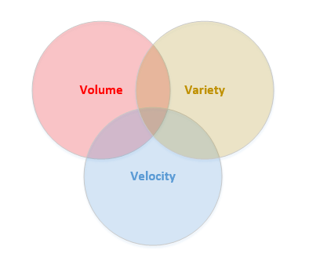
What is Big Data?
Volume
Velocity
Variety
Notes:
First we need to define what big data means.
Big data is a data set that is of a volume, velocity, or variety that is beyond the limitations of conventional data processing tools.
By volume, we mean the size of the data is so big that it can’t fit into memory for analysis or on a conventional hard drive.
By velocity, we mean that the data needs to be processed in near-real time rather than as traditional daily batch operations.
By variety, we mean that the data is no longer just tabular transactional data, we also have unstructured data (e.g. text, images, audio), semi-structured data (e.g. XML, JSON, graph data, etc.)
So we have big data when we are dealing with data that is too big, too fast, or too complex for conventional computing.

Slide 81

Big Data is a Moving Target
What is Big Data today
Will not be Big Data tomorrow
Notes:
However, Big Data is a moving target.
Since desktop computers and servers are getting faster, more memory, and larger disks, what classifies as conventional computing is always changing.
So, what is big data today… may not be big data in the future.
We need to keep this in mind when we’re designing our big data architectures.
If the volume of data we are collecting is growing slower than conventional computers are increasing in performance and capacity, we may only have a temporary big data problem.
However, if the volume of data we are collecting is growing faster than conventional computers are improving, we have a permanent big data problem.

Slide 82

Do I Have Big Data?
Can it fit in memory?
Can it fit on your hard drive?
Can you process it in a day?
Does it fit into tables?
Notes:
So how do you know if you have big data or not?
I’m going to oversimplify this a bit, but essentially, you need to ask yourself a few simple questions:
1. can the data you need to analyze at once fit into a the memory of a single modern computer?
2. can all of the data fit on a single modern hard drive?
3. can you process it in a few hours or would it take multiple days to complete?
4. and Does all of the data you are trying to process fit into tables, or does it involve images, photos, audio, hierarchical data, graph data, etc.
If the answer to any of these questions is no, then you likely have big data.

Slide 83
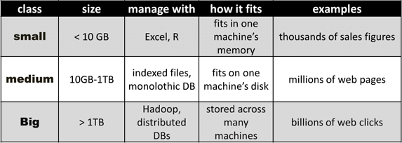
Big Data Decision Table
Note: Last updated in 2010
Source: Michael E Driscoll
Notes:
If you want more concrete examples, here’s a chart from 2010 that tries to put number behind Big Data.
Keep in mind that this is 6 years old, so we need to multiply each of these number by al least a factor of 10 now.

Slide 84
Decision Table for Big Data in R
Class | Rows | Manage with
Small | Less than 1 million | R on desktop computer
Medium | 1 million to 1 billion | R with 3rd party support
Big | More than 1 billion | R with big data support
Source: Jan Wijffels at useR!-Conference (2013)
Notes:
For R specifically, here’s a Big Data decision table for R that Jan Wijffels presented at the useR conference in 2013.
It considers what is big data based solely on the number of rows (rather than bytes), the constraints of R on desktop machines, and the tools available for handling big data in R.
This is about three years old, so we probably need to multiply everything by about a factor of 4.

Slide 85
If you don’t have a big data problem, but you think you have a big data problem, then you’ve just created a big data problem!
Notes:
One of the most important tips for handling big data that I can provide you with though, is that [quote]
I see far to often companies trying to solve small to medium-sized data problems using big-data tools.
This is unfortunate, because it takes a lot more time, effort, and money to build and maintain a big-data solution than to use conventional data tools and processes.

Slide 86
How to Handle Big Data in R
Sampling
Microsoft R Open
3rd-party medium data packages
3rd-party big data packages
Microsoft R Server
Notes:
Ok, so now that we know we either have big data, we don’t have big data (or we’ve created a big data problem that never existed : ) how do we handle it in R?
Well, there are a few ways that I’m aware of.
We’ll cover all four in detail next, but the four options are:
- sampling the data to reduce it to a more manageable size
- using the Microsoft R Open enhanced distribution of R to speed up computation
- using 3rd-party medium-data extension packages and tools for medium-sized data in R
- using 3rd-party big-data extension packages and tools for big data in R
- and using Microsoft R Server.
Let’s discuss each of these in a bit more detail.

Slide 87
Sampling
Randomly selected
Subset of original data
Low-cost solution
Notes:
First, we can use sampling, this is where we only use a randomly selected subset of our data and perform our analysis on that subset.
There are so many ways to perform sampling that entire chapters of books have been written on the subject.
Sampling is a very low-cost way to handle big data problems… however, it kind of defeats the purpose of collecting and storing big data.

Slide 88

Microsoft R Open
Enhance 64-bit R distribution
Multithreaded performance
Only helps with CPU constraint
Package repository snapshots
Source: Microsoft R Open
Notes:
Next, we can use Microsoft R Open (formerly known as Revolution R Open)
Microsoft R Open is a free open-source 64-bit enhanced distribution of R which provides multithreading support to R.
This will only help with the processing speed of your Big Data, it won’t help with the memory or disk space constraints.
In addition, Microsoft R Open takes daily snapshots of the CRAN package repository.
This allows you to ensure that you’re always running with the same packages you used to create your analysis (rather than always using the latest version of each package)

Slide 89
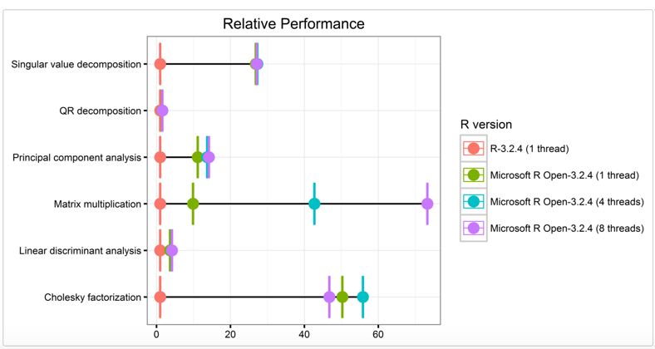
Microsoft R Open Performance
Source: https://mran.microsoft.com/documents/rro/multithread/#mt-bench
Notes:
To give you an idea of how much faster Microsoft R Open performs common statistical operations than the standard single-threaded R distribution, here’s a chart that compares the relative performance.
In red we have the standard single-threaded R distribution.
In green, we Microsoft R Open with one thread.
In blue, Microsoft R Open with four threads.
And in purple, Microsoft R Open with 8 threads.
This is a pretty significant increase in performance for common tasks like matrix multiplication.

Slide 90
3rd-Party Extension Packages
Big Memory
ff
Notes:
Third, we can use 3rd-party extension packages for handing medium-sized data in R like
- Big Memory and ff which process data in chucks on the hard drive rather than loading the entire dataset in to memory at once

Slide 91
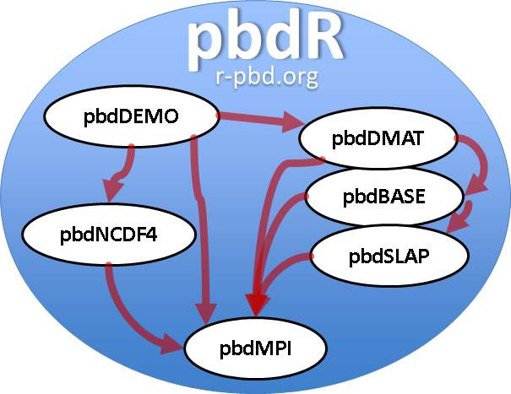
3rd-Party Extension Packages
pbdR
Rhipe
Rhive
Rhbase
Rhdfs,
Rmr
Source: Wikipedia
Notes:
Fourth, we can use 3rd-party big data extension packages in R like:
pbdr (Programing with Big Data in R) which provides a set of big data interfaces for R
In addition, we have R extensions for Hadoop, hive, hbase, hdfs, and map reduce as well

Slide 92
Microsoft R Server
Microsoft R Server
Windows
SQL Server 2016
SUSE Linux
Redhat Linux
Teradata
Hadoop
HD Insight
Source: Microsoft R Server
Notes:
Finally, the most powerful, but costly, of these options for handling Big Data for R is Microsoft R Server (formerly Revolution R Enterprise)
This solution overcomes the processing, memory, and disk constraints with multi-threading, distributed computing, and data source connectors.
In addition, it also overcome constraints from moving large data sets from the data repository to the client machine by executing the query at the data repository and returning the results to the client machine.
It supports, Windows, SQL Server 2016, Linux, Teradata, Hadoop, and (soon) HDInsight platforms.

Slide 93
No Code Demo or Lab 6

Slide 94
Machine Learning
Notes:
Now that we’ve learned about statistical models and big data, we’re ready to learn about machine learning and how to train, test, and implement machine learning models

Slide 95

What is Machine Learning?
Subtype of artificial intelligence
Learning without being programmed
Similar to statistical modeling
Similar to data mining
Source: Futurama
Notes:
First, what is machine learning?
Machine learning is a subfield of artificial intelligence
The goal of artificial intelligence is to create machines that act rationally in response to input in their environment and make decisions to achieve a goal of some kind.
Machine learning is artificial intelligence where the machines are learning to complete tasks with out being explicitly programmed to complete those tasks.
All modern machine learning is based on statistics, so we make heavy use of statistical methods and theory.
In addition, machine learning is similar (or the same, depending upon who you ask) to data mining.

Slide 96

How does Machine Learning Work?
Uses statistical models
Model’s parameters are trained with algorithm and input data
Model is used to predict output
Prediction vs. explanation
Source: Futurama
Notes:
Because machine learning is built on statistics, we use statistical models for most of our machine-learning algorithms.
We have a training algorithm that uses the training data to set the parameters for the statistical model.
Then we use the model to predict answers given entirely new data that the model has never seen based on the probabilities in the statistical model.
The main difference between statistical modeling and data mining vs. machine learning is that:
… with statistical modeling and data mining, we create the model in attempt to explain things.
… with machine learning, we attempt to predict things instead.

Slide 97

What Can Machine Learning Do?
Classification
Regression
Clustering
Anomaly detection
Source: Futurama
Notes:
So what can machine learning actually do?
Well, despite all the cool things we hear about machine learning doing for google, Netflix, and Amazon, there really are only four types of questions machine learning algorithms can answer:
First, we have Classification - where we predict categorical values
Next, we have Regression - where we predict numeric values
Then we have Cluster Analysis – where we find patterns in the data
Finally, we have Anomaly Detection – where we find odd things (called outliers) in the data
All of the complex and cool stuff that machine learning does is essentially built on answering these four types of questions.

Slide 98

Types of Machine Learning
Supervised
Unsupervised
Reinforcement
Source: Futurama
Notes:
There are essentially three main types of machine learning.
First, we have Supervised learning, where humans provide labels (i.e. output value) for each row of input data in the test data set.
… then the machine learns how to predict output given new input row (e.g. classification and regression).
Next, we have Unsupervised learning, where humans do not provide any labels
… and the machine learns structure of data or finds patterns in data (e.g. clustering).
Finally, we have Reinforcement Learning, where the machine attempts to achieve a goal in a dynamic environment
… and receives rewards or punishment (i.e. reinforcement) depending upon whether it is getting closer to achieving the goal or not.
We looked at supervised learning when we built our linear regression model and used it to predict new values in our last demo.
We’ll learn how to do unsupervised learning when we perform our cluster analysis in our next demo.

Slide 99
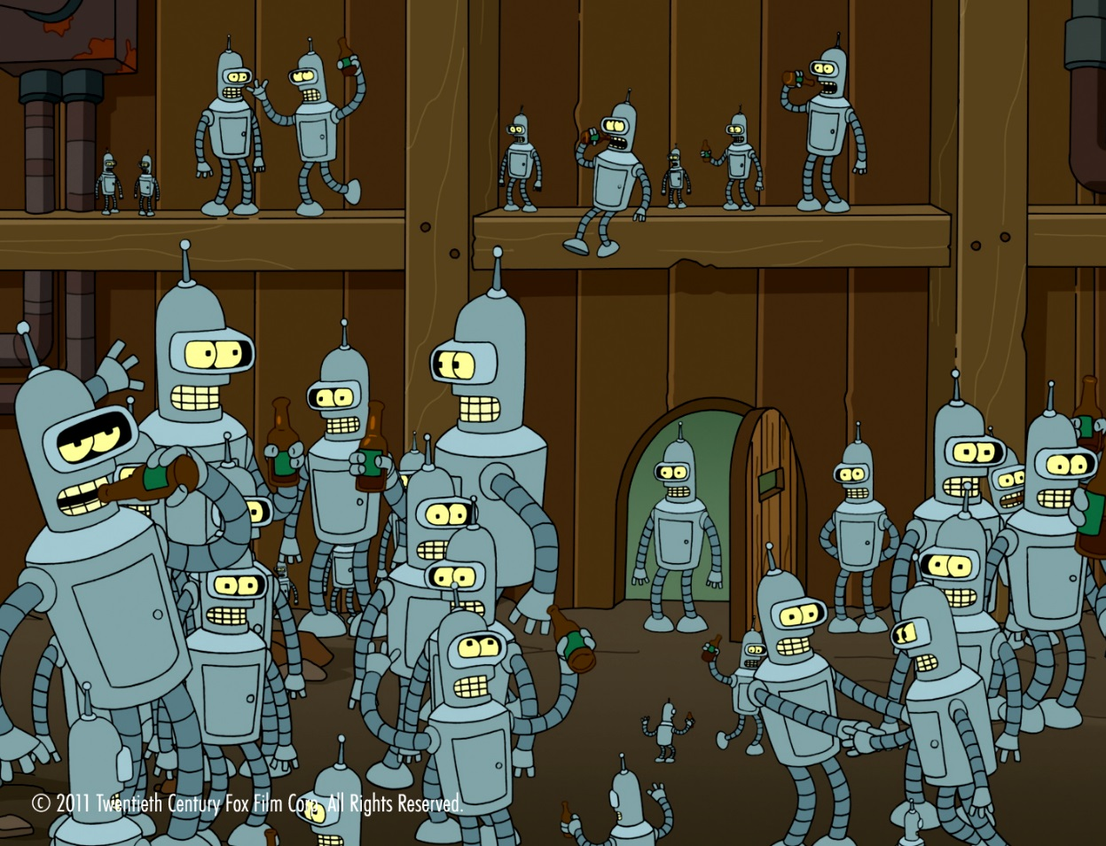
Types of ML Algorithms
Decision Trees
Naïve Bayes Classifier
Linear Regression
Logistic Regression
Support Vector Machines
Neural Networks
K-Means Clustering
Ensemble Learning
Source: Futurama
Notes:
There are many types of machine learning algorithms in existence with new algorithms being created every day.
Here are just a few of the most popular types of algorthms.
For each of these general algorithm types, there may be dozens of different specific implementations.
- Decision Tree – create a tree or forest of trees which represents the decision-making process of choosing an output given each input value
- Naïve Bayes Classifier – assume that all input variables are conditionally independent an compute the probability of the output based upon the contribution of each input
- Linear Regression – predict a continuous output given one or more input values modeled one or more a linear functions
- Logistic Regression – predict a categorical output given on or more input values modeled by logistic functions
- Support Vector Machines – use the kernel trick to project the data into a hyper-dimensional space separated by a maximum-margin hyperplane
- Neural Networks – use a overly-simplified mathematical model of neurons in the brain to predict an output given a set of inputs
- K-Means Clustering – use a predetermined number (k) random starting points and mathematically converge them to the center of each cluster of data points to divide the data points into a set of clusters.
- Ensemble Learning – use a bunch of simple ML algorithms and have them vote for the best output (e.g. decision forests)
We can mentally organize all of these algorithms into supervised or unsupervised
… and by which of the four types of ML questions they are answering.

Slide 100
The Machine Learning Process
Find a question
Prepare the data
Train the model
Evaluate the model
Deploy the model
Monitor the model
Find a question
Prepare the data
Train the model
Evaluate the model
Deploy the model
Monitor the model
Notes:
The machine learning process is, again, an iterative process.
First, We start by finding a question that we want to attempt to answer using machine learning.
Second, we prepare the data for the machine learning algorithm.
This step is essentially the same tasks as we perform during data munging.
Third, we train the model.
We do this by splitting our data set into a training set and a test set.
Then we use the training set to train the parameters of the model using our learning algorithm.
Fourth, we evaluate the model.
We have numerous ways to determine how accurate or reliable the machine learning model is given the training data provided.
We will also likely compare multiple machine learning algorthms in this phase, and tune the parameters of the model to avoid issues like model overfitting.
Fifth, once we have a model with a reliability that is acceptable for production, we deploy it to production.
Finally, we must monitor, update, and maintain the model because human behaviors change in response to the application of the machine learning models over time.
We don’t have time to go though this process step by step during our demo and lab, but we will go through a few of the steps.
Please note, that machine learning isn’t something you learn in a hour… it requires quite a bit of knowledge and practice to get good at applying reliable machine learning models in production.
NOTE: We already did a simple form of supervised machine learning during our linear regression modeling lab, so you’re getting two machine learning examples for the price of one today.

Slide 101
Photos by Radomił Binek, Danielle Langlois, and Frank Mayfield
Notes:
Joe was so impressed by our linear regression analysis that he proposes a much more difficult challenge to us.
He says that he also needs to organize batches of flowers by their species.
He can inspect each flower by hand, but it takes too much time to be cost effective.
He wonders if it might be possible to predict the correct species of Iris flower given just the lengths and widths of the petals and sepals derived from his optical scanning technology.
The three species of Iris flowers that we have are:
[1] iris virginica,
[2] iris versicolor,
[3] and iris setosa.
We think about the question for a minute and it occurs to us that we might be able to perform a cluster analysis to see if the data are separable into distinct and predictable categories for each species.
However, we’ll have to inspect the data again to see if this will be possible.
So we’re going to attempt to perform a cluster analysis using the k-means clustering algorithm, to see if we can correctly classify the species of flower based solely on the lengths and width of the petals and sepals of these flowers.

Slide 102
Code Demo

Slide 103
Lab 7 Machine Learning

Slide 104

Notes:
So now that we’ve helped Joe get his new business up and running using our data analysis skills, he leave his position as CFO and moves on to pursue his dream of running his own high-end flower shop catering to the rich and famous in Hollywood.
[1] He takes us out to celebrate his grand opening, his flower shop is a huge success, and Joe lives happily ever after.

Slide 105
R in Practice
Notes:
Finally, lets learn about how to use R in practice (i.e. how we’ll deploy R into production and best practices for data science with R).

Slide 106
How to Use R in Practice?
Deploying R to production
Best Practices
Creating reproducible research
Notes:
First, we’ll discuss how to deploy R in production.
Second, we discuss industry best practices for data science with R.
Finally, we’ll discuss creating reproducible research.
These are some of the things that are typically not discussed during presentations or workshops on R.
So, I’ve made some time to discuss the three most important topics that are typically skipped over or omitted.

Slide 107
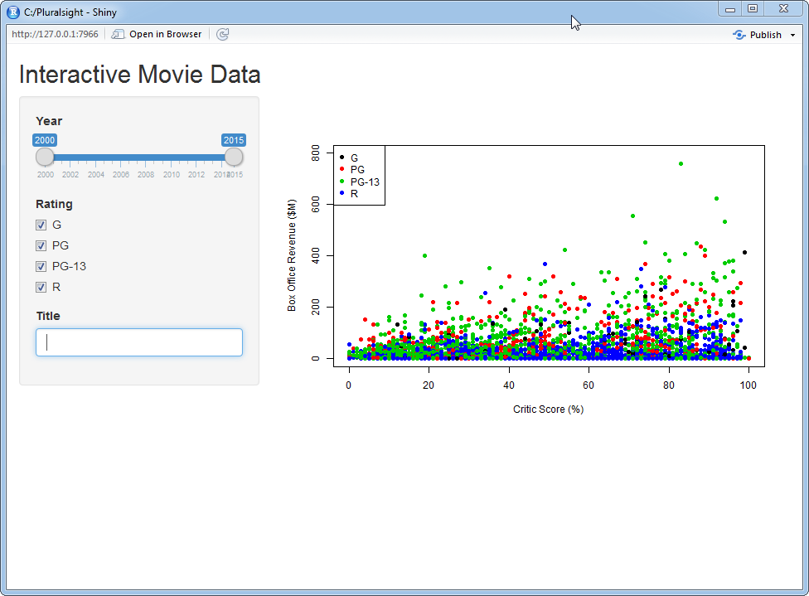
How to Deploy to Production
Export charts (Rstudio)
Create documents (Markdown)
Create interactive reports (Shiny)
Deploy to Server (R Server)
Deploy to Cloud (Azure ML)
Notes:
First, if we want to deploy R to production, we have several ways to do so.
We can export charts within Rstudio.
We can create documents using R markdown with knitr and sweave.
We can Create interactive web reports using Shiny.
We can Deploy to a server with either DeployR (free open source) or R Server (enterprise class)
And we can Deploy to the cloud using either Azure ML or Azure Data Science Virtual Machine
We’ll take a look at the first three during our next demo.

Slide 108
Code Demo

Slide 109

Notes:
Now let’s spend a few minutes discussing industry best practices for data science.
In addition, we want to learn how to avoid making errors, and invalid claims, with our data science.
This is a very important topic, because it is very easy to unintentionally mislead or misrepresent data when we create our data analyses.
These best practices are general tips that are advisable in most contexts.
However, context is very important, so there may be some specific contexts where this advice is not applicable.
So, it’s important that you learn the general rules and then learn when it is appropriate to follow them and when it is advisable to do something else.

Slide 110
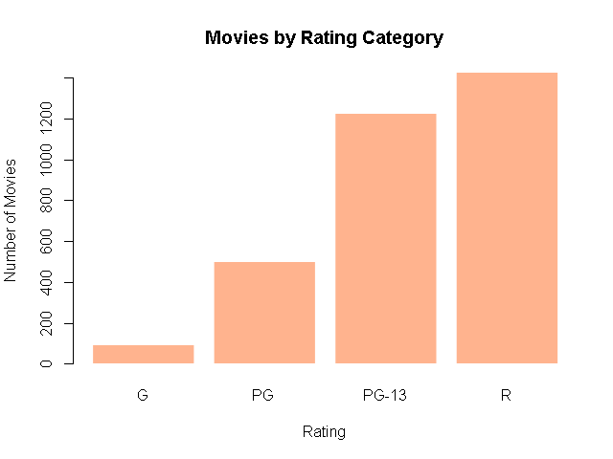
Start with a Question
How many movies were released in each rating category from 2000 to 2015?
Notes:
First, we should start each data analysis with a question that we’re attempting to answer.
[1] For example, our question might be, “How many movies were released in each rating category from 2000 to 2015?”
Once we have our question in mind then we can attempt to answer that question using a data model of some kind.
In this case, our question involves a comparison of observations for a qualitative variable (i.e. movie ratings).
[2] So, we could create a frequency table or a bar graph of the number of movies by rating category to answer this question.
Starting with a question in mind helps us focus on a specific goal and helps us choose type of data analysis and the specific tool that is most appropriate to answer the question.

Slide 111
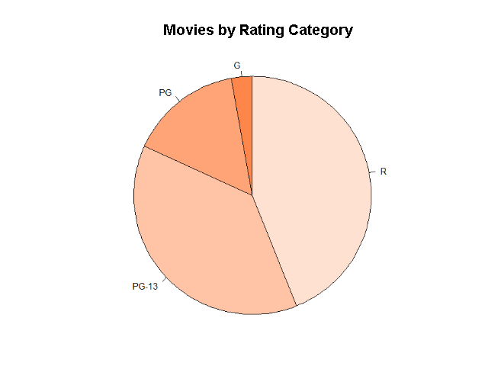
Use the Right Tool for the Job
Notes:
Second, it’s important that we use the right tool for the job.
This starts with understanding the question that we are trying to answer for our audience.
Ask yourself, what information is our audience trying to learn from our analysis?
Are they trying to compare two values to see which is larger?
Are they trying to see rates of change over time?
Or are they trying to see how values are distributed across a variable?
[1] For example, if our audience is interested in comparing movie rating categories, a pie chart may not be the best way to present this information.
[2] However, a bar chart is an excellent tool to communicate this information for comparison purposes.
Once we know the question our audience is asking, then we then need to know which type of data analysis communicates the answer in the most effective way for our audience.
This requires learning which types of data analysis are most appropriate to answer specific types of questions in specific contexts.

Slide 112
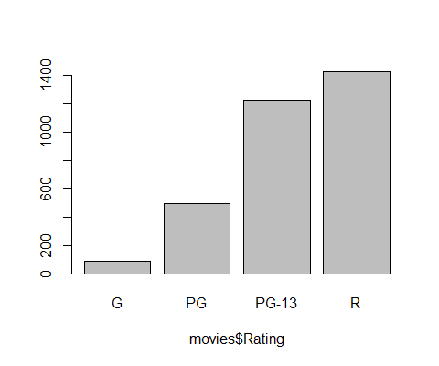
Know Your Audience
Notes:
Third… we must know our audience… we should always consider who will be viewing the results of our data analysis and then format the output of our analysis accordingly.
We could be producing our analysis for a small audience who is very familiar with the data and context or we could be producing our analysis for a large audience who is unfamiliar with the data or the context.
We should invest time and effort in proportion to the size of the audience, their familiarity with the data and domain, and based on the potential impact of decisions that may be made using our data analysis.
In the first example, we have an exploratory data visualization where we’re just using the data visualization to learn about the data ourselves, so we don’t need clean up the data visualization and add appropriate label.
In the example on the right, we have an expository (or explanatory) data visualization, where we are communicating our findings to a wider audience, so we do need to clean up the data visualization and add appropriate labels.

Slide 113
Create Clean Data Analyses
Notes:
Fourth, we want our data analyses to be clean, straightforward, and as simple as possible.
Our goal with our data analyses is to communicate the necessary information as clearly as possible with as few words as is necessary.
We don’t want to overly wordy with our analysis, but we do need to provide sufficient information and context so that our findings will not be misinterpreted.
In addition, our goal with data visualizations is to maximize the data-to-ink ratio of our data visualizations (i.e. we want to communicate as much information as possible using the minimum amount of digital ink).
This means we should strive to eliminate all “chart junk” as data visualization expert, Edward Tufte, likes to call it (i.e. anything on our chart that doesn’t directly help communicate the core information of our data visualization).
[1] For example, here is a data visualization that contains a tremendous amount of chart junk.
It is a 3D graph but the 3rd dimension communicates no relevant information.
It has each bar color coded, and a legend, but this is redundant information since each bar has an x-axis label.
Each bar also has unnecessary special effects like rounded corners, surface reflectivity, and drop shadows.
It has a beige texture on the main canvas and the back wall of the bar graph has a granite texture.
It uses multiple fonts that are difficult to read, are heavily bolded, and use 100% black text.
In addition, we also have thick solid-black y-axis gridlines that add even more clutter to this already heavily cluttered graph.
[2] Instead, we can communicate the exact same information with a much simpler graph, like so.
We’ve eliminated the unnecessary 3D bars, special effects, and backgrounds.
We’ve eliminated the redundant color-coding of the categories and the legend.
We’ve cleaned up the fonts, removed the bolding, and lightened the text.
… and we’ve thinned out and lighted up the y-axis grid-lines.
However, both of these charts are communicating the exact same information.
The second chart is just doing so in a way that is much more efficient and effective.
When we’re creating data visualizations we want to keep things clean and simple…
… often times, less is more.

Slide 114
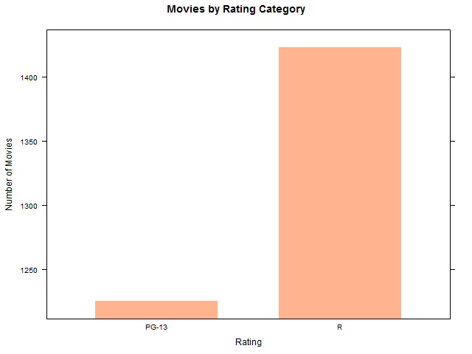
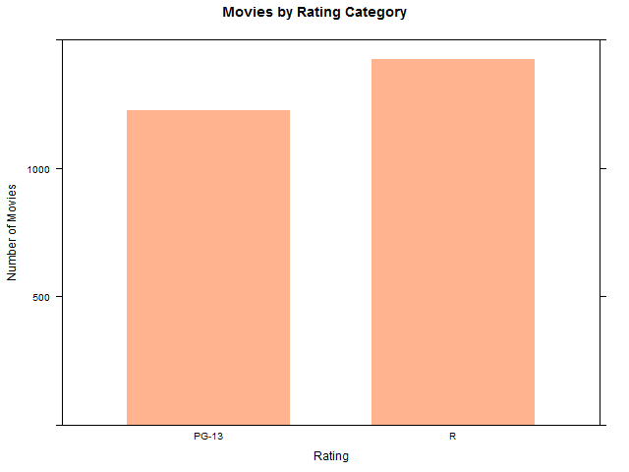
Avoid Biases and Information Distortions
Notes:
Finally, we want to avoid biases and information distortions in our data analyses.
Our brains have many hidden biases that can skew the results of our analyses.
In addition, it is very easy to lie with data… whether these lies are intentional or unintentional.
In fact there are so many biases and ways to visually misrepresent data using data visualizations that entire books have been written on the subject.
For example, lets say we’re interested in comparing the total number of PG-13 movies to R-rated movies.
[1] We could create a graph where the y-axis begins at an arbitrary location (e.g. 1,200 movies).
This makes it appear as if there is a significantly larger number of R-rated movies than PG-13 movies.
[2] However, if we create this same graph with the y-axis starting at zero, these two values don’t look all that different after all.
Simply by changing the start and end of our y-axis we can unintentionally distort the reality of our data.
Other examples of information distortion involve using exaggerated 3D perspectives, using the size of shapes rather than their area for comparison, and breaking established data visualization conventions.
It is important that we learn how someone can lie with a data analysis in order to avoid accidentally lying with our own analyses.
In addition, it’s also a very important skill for recognizing when we are being lied to by someone else’s data visualizations.

Slide 115

Create Reproducible Research
Replication is hallmark of science
Big issue in science right now
Allows other to verify findings
Creates transparency
Allows other to build upon work
Source: https://blog.mendeley.com
Notes:
The final best practice I would like to discuss is creating reproducible research.
Replication of scientific experiments is one of the key foundations of science, however, many scientists and organizations have created great barriers to replicating studies in order to verify them.
This is currently a huge problem in science and academia right now and we really need to do something about it.
Ultimately, whenever you perform a data analysis, you need to make sure that your results are reproducible by others so that they can check your work, re-run the experiment, and verify your results.

Slide 116
How Do We Create Reproducible Research?
Provide access to
Raw data
Source code
Script all analysis steps
Use source control
State all assumptions
Use markdown
Source: https://blog.mendeley.com
Notes:
It’s actually quite easy to create reproducible research with modern technology, which is why I’m so surprised that this is still an issue.
First, we need to publish all of our research and findings with the original data we used to perform the data analysis and the source code we used to perform the analysis.
Ideally this should be done in public for publicly funded studies and within your organization (where applicable) for privately funded research.
However, there’s a lot of red tape involved, so please be sure to check with your specific organization to know what you can and can’t do with the data and source code.
Second we need to script all of the steps in our analysis… there should be no manual steps performed… ideally everything should be reproducible by the single click of a button.
Third, we want to store all of our source code in source control repositories like git or svn.
Fourth, we want to explicitly state all of our assumptions that we make during our analysis.
Finally, it’s a good idea to document our analysis steps using R markdown so that the documentation can be both read by humans and executed by machines.
Some parts of Science are a bit broken right now.
It’s up to each of us to help fix the issues.
By following these simple steps we can have a huge impact on reliability of human scientific knowledge.

Slide 117
Where to Go Next…
Coursera: https://www.coursera.org/specializations/jhu-data-science
Revolutions: http://blog.revolutionanalytics.com
Flowing Data: http://flowingdata.com
R-Blogger: http://www.r-bloggers.com
Notes:
So where do we go from here?
Fortunately, there are a lot of really good resources available on the internet.
- Coursera has an online 10-course data science specialization through John’s Hopkins that is based on using R for data science
- Revolution Analytics - for the latest industry news
- Flowing Data – for data visualizations
- R-Blogger – for the R community
[Pause]

Slide 118
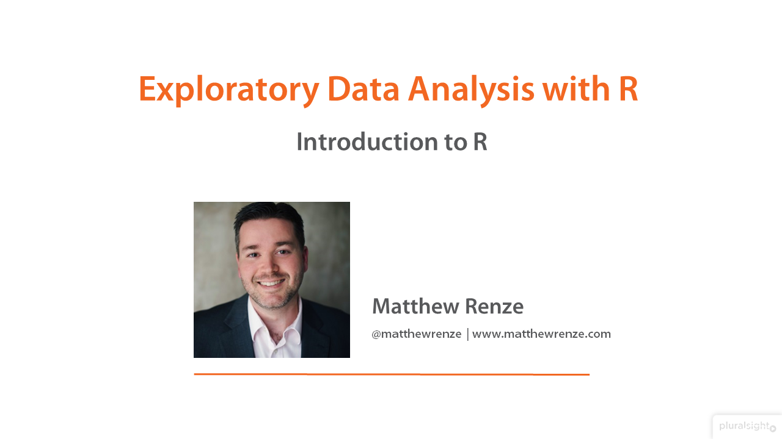
www.pluralsight.com/authors/matthew-renze
Notes:
In addition, if you’re interested in online training, I should probably as mention that I’m the author of multiple Pluralsight courses on R including: EDA with R and Data Visualization with R.
My EDA with R course covers similar information to this workshop, however, it goes much deeper into all the concepts.
My data visualization with R course goes much deeper into creating and interpreting univariate and bivariate data visualizations.
So if you felt like the information in this presentation was very interesting, but wish I would have gone slower or covered more material, these courses are perfect for you.
And as a side note, I’m have three other courses on data science topics with R currently in development.
[NOTE: Free 30-day Pluralsight Subscription]

Slide 119
Conclusion

Slide 120
Conclusion
Introduction
Transforming Data
Descriptive Statistics
Data Visualization
Statistical Modeling
Handling Big Data
Machine Learning
R in Practice
Notes:
In conclusion, today we learned about practical data science with R.
- transforming and cleaning our data.
- descriptive statistics and how to describe our data in numerical ways.
- data visualization and how to create and interpret a variety of data visualizations
- statistical modeling and how to make statistical inferences with these models
- big data and how to handle it within R
- machine learning and how to train, evaluate, and make predictions
- finally, we learned about R in practice (i.e. deploying to production, reproducible research, and best practices)
[Pause]

Slide 121
Feedback
Feedback is very important to me!
One thing you liked?
One thing I could improve?
Notes:
One last thing… feedback is very important to me.
I use feedback to continuously improve my presentations and workshops every time I give them.
So be sure to fill out your feedback forms
In addition, please let me know:
- one thing you liked about my presentation
- and one thing you think I could improve upon
This information typically helps me out more than the quantitative metrics.
I promise you won’t hurt my feelings.

Slide 122
Contact Info
Matthew Renze
Twitter: @matthewrenze
Email: matthew@renzeconsulting.com
Website: www.matthewrenze.com
Thank You! : )
Notes:
Here’s my contact info in case you’d like to get in contact with me or learn more about anything we’ve discussed today.
Feel free to check out my website, send me a tweet, or email me if you have any questions or feedback.
I would love to hear from you : )
If you liked this workshop, please be sure to send out a tweet about your favorite idea, topic, a photo, or screenshot of your lab work
[1] Thank You!
[Any Questions?]
[Any Feedback?]

